Slide 1

Machine Learning
By Leo K A

Slide 2
Machine Learning
What
Why

Slide 3
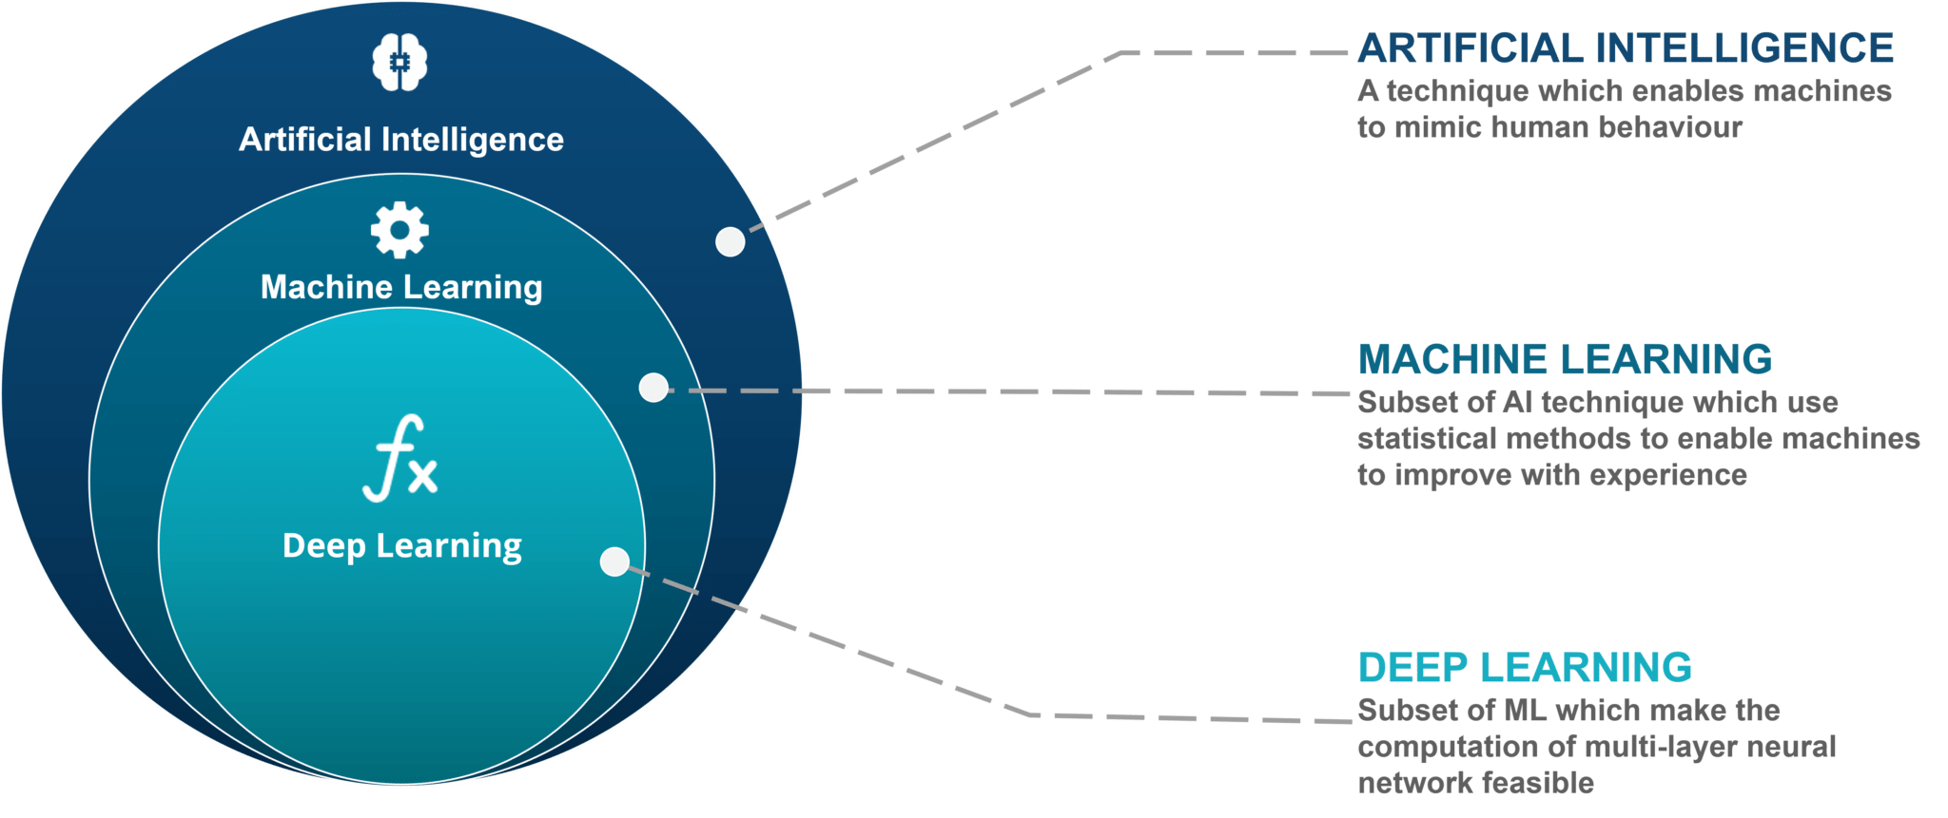
AI vs ML vs DL

Slide 4
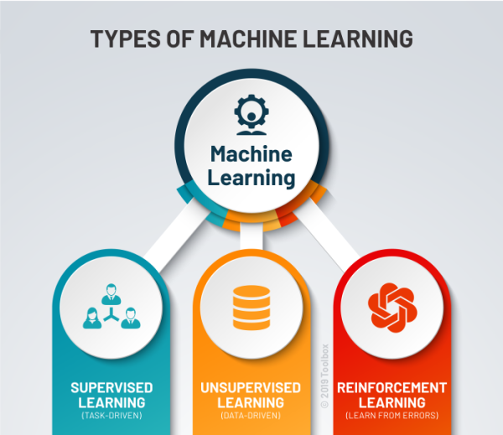
Types of ML

Slide 5
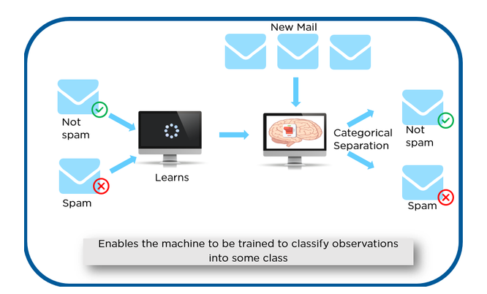
Supervised Learning Algorithm

Slide 6
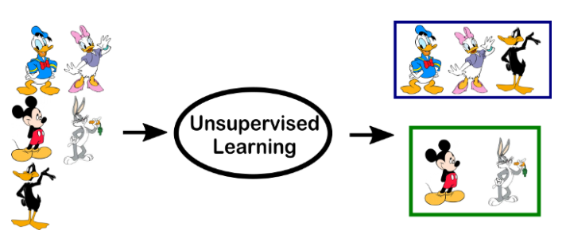
Unsupervised Learning Algorithm

Slide 7
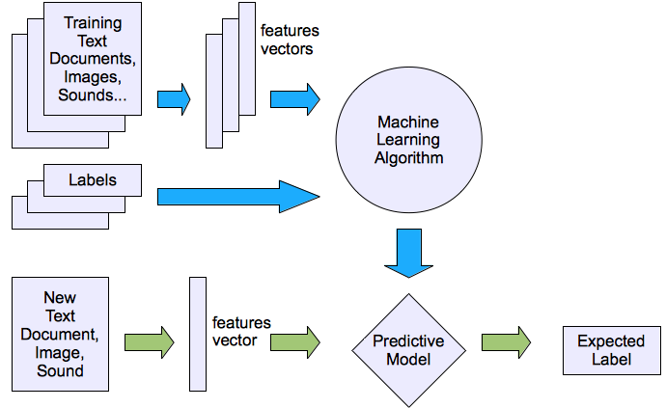
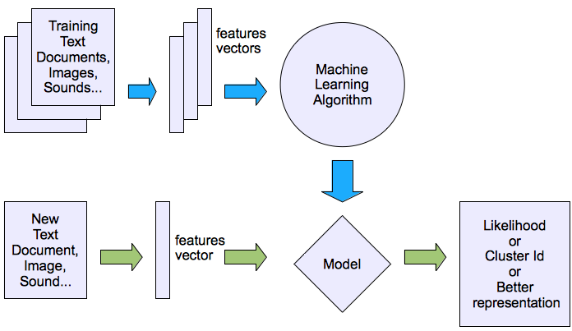
Supervised learning
Unsupervised learning

Slide 8
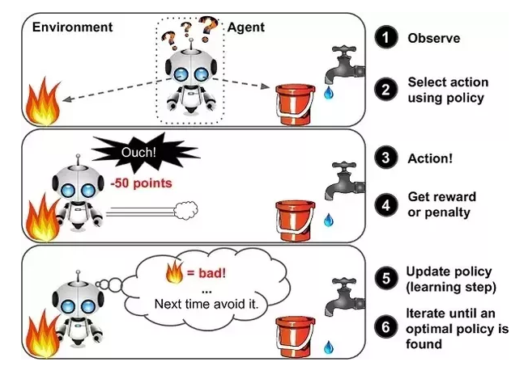
Reinforcement Algorithm

Slide 9
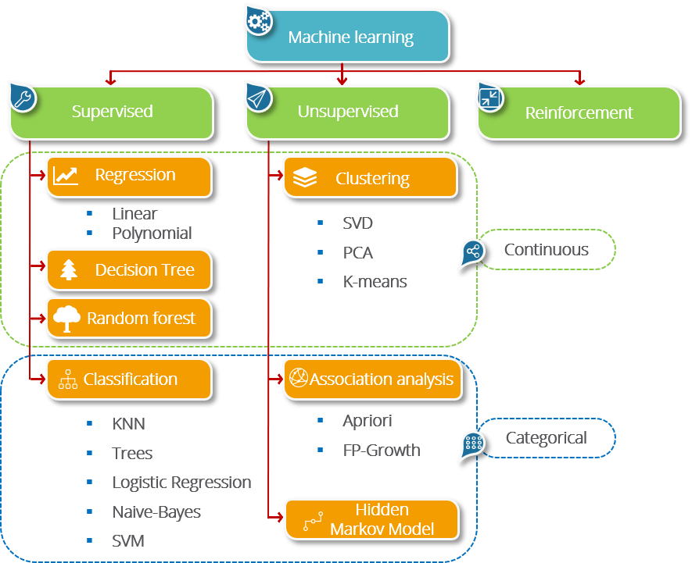
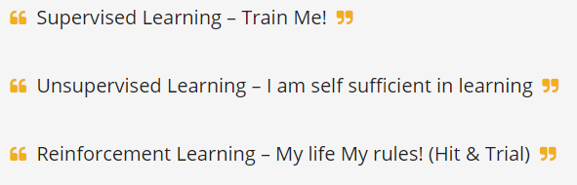
ML Types : In Nutshell
Training Set and Test Set
Apply the model
Predicate the future Set

Slide 10
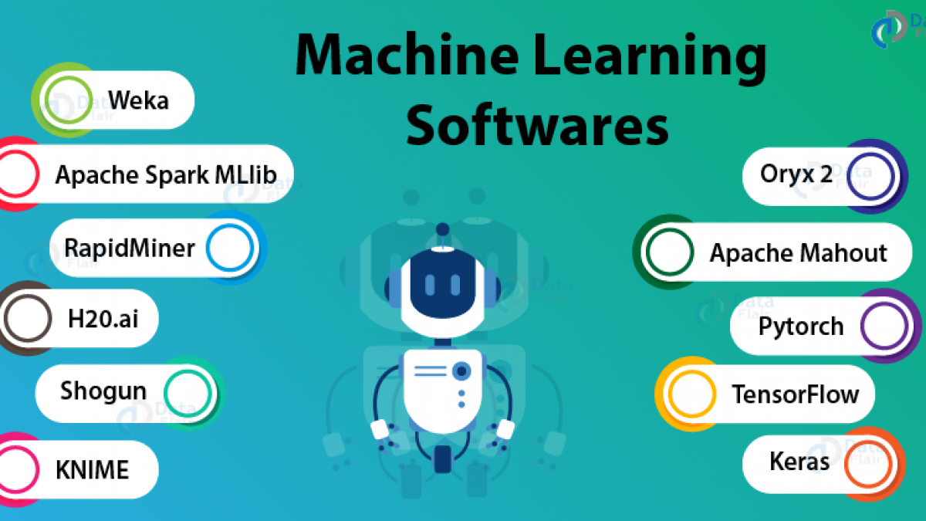

Slide 11


